Slide 1
fx
Excel
Functions
Complete Reference - Every Category with Examples and Explanations
300+ Functions | 12 Categories | Nigerian Business Examples | Line-by-Line Explanations
Math and Trig
Statistical
Logical
Lookup and Ref
Text Functions
Date and Time
Information
Financial
KAJOLA GBENGA ADEWALE
Array (365)
Database
Switch/Choose
Engineering
Data Analytics Expert
Notes:
Excel Functions complete reference deck. 12 categories covering 300+ functions. Every slide has the function syntax, a real business example output, and a line-by-line explanation table. Use alongside the Excel teaching deck or as a standalone function reference guide.

Slide 2
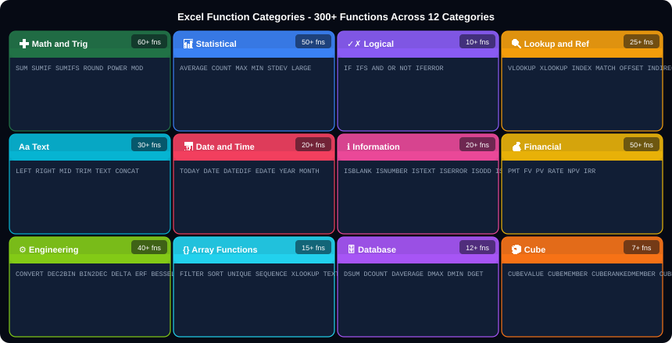
ALL EXCEL FUNCTION CATEGORIES - 300+ Functions Overview
Notes:
Function categories overview. The most used categories in business are: Math/Trig (SUM, SUMIF, SUMIFS), Statistical (AVERAGE, COUNT, MAX), Logical (IF, IFS, IFERROR), Lookup (VLOOKUP, XLOOKUP, INDEX-MATCH), and Text (TRIM, PROPER, LEFT, RIGHT). Array functions (FILTER, SORT, UNIQUE) require Excel 365 or Excel 2021.

Slide 3
HOW EXCEL FUNCTIONS WORK - Anatomy of a Formula
=
SUMIFS
(
C2:C100
A2:A100
"Lagos"
B2:B100
"&gt;50000"
Equals sign
Function name
Opening bracket
sum_range
criteria_range1
criteria1
criteria_range2
criteria2
Every formula must start with = to tell Excel this is a formula, not plain text.
The Excel function being called. Not case-sensitive. SUMIFS = SUMIFS = sumifs.
Always required after function name. Encloses the arguments.
The range to ADD UP. For SUMIFS this comes FIRST (different from SUMIF).
The range to CHECK. Excel compares each cell here against the criteria.
What to look for in criteria_range1. Text must be in quotes. Numbers do not need quotes.
Second range to check. Can add up to 127 criteria_range/criteria pairs.
Operator + value in quotes. Operators: &gt; &lt; &gt;= &lt;= &lt;&gt; (not equal). E.g. "&gt;50000".
=SUMIFS( C2:C100, A2:A100, "Lagos", B2:B100, "&gt;50000" )
rules.xlsx
-- Golden Rules for Excel Functions --
1. Every formula starts with = (equals sign)
2. Arguments are separated by , (comma)
3. Text values must be in "quotes" - numbers do not need quotes
4. Ranges use : (colon): A1:A100 means A1 through A100
5. Press Shift+F3 to open Insert Function dialog with argument helper
6. Press Ctrl+` to show all formulas instead of results
7. F4 inside a cell reference toggles $ to make it absolute
8. Wrap any formula with =IFERROR(formula, "error message") to handle errors
Notes:
How functions work. The anatomy slide is the foundation. Every student must understand: equals sign starts formula, parentheses enclose arguments, commas separate arguments, quotes around text. The Shift+F3 tip (Insert Function) is invaluable because it shows each argument with its description while you build the formula.

Slide 4
➕
CATEGORY 01
Math and Trig Functions
SUM, SUMIF, SUMIFS, ROUND, INT, MOD, POWER, SQRT, ABS and more

Slide 5
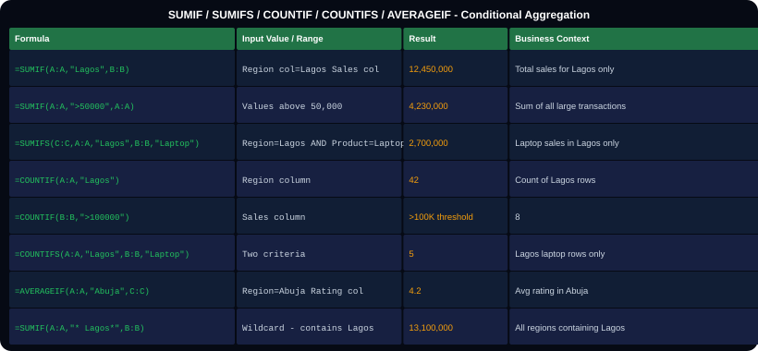
MATH 01 - SUM, SUMIF, SUMIFS - The Most Used Functions
Function
What It Does
=SUM(B2:B100)
Adds all numeric values in B2 through B100. Ignores text and blanks.
=SUMIF(range, criteria, sum_range)
Sums sum_range only for rows where range matches criteria. Three arguments.
=SUMIF(A:A,"Lagos",B:B)
Sum column B where column A = 'Lagos'. Most common usage.
=SUMIF(A:A,"&gt;50000",A:A)
Sum A where A &gt; 50,000. Range and sum_range are the same column.
=SUMIF(A:A,"*Lagos*",B:B)
Wildcard * matches any characters before or after Lagos.
=SUMIFS(C:C,A:A,"X",B:B,"Y")
SUMIFS: sum_range comes FIRST. Then criteria pairs. Multiple AND conditions.
=SUMIFS(C:C,A:A,"Lagos",B:B,"&gt;50000")
Sum C where A=Lagos AND B&gt;50000. Both must be true.
sumif.xlsx
=AVERAGEIF(A:A,"Lagos",B:B)
Average of B where A = Lagos. Same structure as SUMIF.
-- Key Difference: SUMIF vs SUMIFS --
SUMIF: (range, criteria, sum_range)
SUMIFS: (sum_range, range1, criteria1, ...)
Notice: in SUMIFS, sum_range comes FIRST!
-- Criteria operators --
"&gt;50000" "&gt;=100" "&lt;&gt;Lagos" "*Lap*"
=AVERAGEIFS(C:C,A:A,"X",B:B,"&gt;0")
Average with multiple conditions. Same structure as SUMIFS.
Notes:
SUMIF vs SUMIFS. The argument order difference is the most common source of errors. SUMIF: range to check FIRST, then criteria, then range to sum LAST. SUMIFS: range to SUM FIRST, then pairs of (range, criteria). Also: criteria operators must be in quotes including the number: ">50000" not >50000.

Slide 6
MATH 02 - ROUND, INT, MOD, POWER, SQRT, CEILING, FLOOR
math2.xlsx
Function
What It Does - When to Use
-- Rounding Functions --
=ROUND(3.14159, 2) -&gt; 3.14
=ROUND(2456, -2) -&gt; 2500 (round to 100s)
=ROUNDUP(3.001, 0) -&gt; 4 (always up)
=ROUNDDOWN(3.999, 0) -&gt; 3 (always down)
=INT(3.9) -&gt; 3 (truncate down)
=INT(-3.2) -&gt; -4 (towards -inf)
=TRUNC(3.9) -&gt; 3 (towards zero)
=CEILING(4.2, 0.5) -&gt; 4.5 (up to nearest 0.5)
=FLOOR(4.9, 0.5) -&gt; 4.5 (down to nearest 0.5)
=MROUND(17, 5) -&gt; 15 (nearest multiple of 5)
-- Other Math Functions --
=MOD(17, 5) -&gt; 2 (remainder)
=MOD(100, 7) -&gt; 2 (remainder of 100/7)
=POWER(2, 10) -&gt; 1024 (2 to the 10th)
=SQRT(144) -&gt; 12 (square root)
=ABS(-450000) -&gt; 450000 (absolute value)
=PI() -&gt; 3.14159... (pi constant)
=EXP(1) -&gt; 2.718 (e constant)
=LN(100) -&gt; 4.605 (natural log)
=LOG(1000, 10) -&gt; 3 (log base 10)
=FACT(5) -&gt; 120 (5! factorial)
=COMBIN(10, 3) -&gt; 120 (combinations)
=PERMUT(10, 3) -&gt; 720 (permutations)
=RAND() -&gt; 0.734 (random 0 to 1)
=RANDBETWEEN(1, 100) -&gt; 47 (random integer)
=SUBTOTAL(9, B2:B100) Sum ignoring hidden rows
=AGGREGATE(9,5,B2:B100) Sum ignoring hidden+errors
=ROUND(num, digits)
Rounds to specified decimal places. digits=0: whole number. digits=-2: round to hundreds. Most commonly used rounding.
=ROUNDUP(num, digits)
Always rounds AWAY from zero. 3.001 becomes 4 with digits=0. Use for tax calculations where you always round up.
=CEILING(num, significance)
Rounds UP to nearest multiple of significance. CEILING(4.2, 0.5) = 4.5. Use for time rounding (15-minute slots).
=FLOOR(num, significance)
Rounds DOWN to nearest multiple. FLOOR(4.9, 0.5) = 4.5. Use for price rounding to nearest 50 Naira.
=MOD(number, divisor)
Returns the REMAINDER after division. MOD(17,5)=2 because 17/5 = 3 remainder 2. Use to identify odd/even rows.
=INT(number)
Drops the decimal portion, always towards -infinity. INT(3.9)=3. INT(-3.2)=-4. Different from TRUNC for negatives.
=RANDBETWEEN(low, high)
Random integer between low and high. Recalculates every time sheet changes. Press F9 to force recalculation.
=SUBTOTAL(function_num, range)
Performs calculation ignoring hidden rows. function_num: 1=AVERAGE, 9=SUM, 2=COUNT. Essential with filtered data.
=AGGREGATE(function, options, range)
Like SUBTOTAL but also ignores error values. More flexible with 19 function types.
Notes:
Math functions. SUBTOTAL is critically important for filtered lists. =SUM(B2:B100) will sum ALL rows even if rows are hidden by a filter. =SUBTOTAL(9,B2:B100) sums only VISIBLE rows. This is the correct function to use in filtered dashboards. Same for SUBTOTAL(2,...) for COUNT and SUBTOTAL(1,...) for AVERAGE.

Slide 7
📊
CATEGORY 02
Statistical Functions
AVERAGE, COUNT, MAX, MIN, LARGE, MEDIAN, STDEV, PERCENTILE

Slide 8
STATISTICAL - COUNT, AVERAGE, MAX, MIN, RANK, PERCENTILE
stats.xlsx
Function
Key Explanation
-- Counting Functions --
=COUNT(A1:A100) Count numeric cells only
=COUNTA(A1:A100) Count non-empty cells
=COUNTBLANK(A1:A100) Count empty cells
=COUNTIF(A:A,"Lagos") Count cells = Lagos
=COUNTIF(A:A,"&gt;50000") Count cells &gt; 50000
=COUNTIFS(A:A,"Lagos",B:B,"Laptop")
-- Average Functions --
=AVERAGE(B2:B100) Mean of numeric values
=AVERAGEIF(A:A,"Lagos",B:B)
=AVERAGEIFS(C:C,A:A,"Lagos",B:B,"&gt;0")
=MEDIAN(B2:B100) Middle value (50th pct)
=MODE(B2:B100) Most frequent value
=GEOMEAN(B2:B10) Geometric mean
=HARMEAN(B2:B10) Harmonic mean
=TRIMMEAN(B2:B100,0.1) Mean excluding top/bottom 10%
-- Max, Min, Rank --
=MAX(B2:B100) Highest value
=MIN(B2:B100) Lowest value
=LARGE(B2:B100, 2) 2nd highest
=SMALL(B2:B100, 3) 3rd lowest
=RANK(A1,B:B,0) Rank of A1 in B:B desc
=RANK.EQ(A1,B:B,1) Rank ascending (ties=same)
=PERCENTILE(B:B,0.75) 75th percentile value
=QUARTILE(B:B,1) Q1 (25th percentile)
=FREQUENCY(data,bins) Frequency distribution
=COUNT vs COUNTA
COUNT only counts numeric cells. COUNTA counts ALL non-empty cells including text. Use COUNTA to count text columns like names or regions.
=MEDIAN vs AVERAGE
Median is the middle value when sorted. For skewed data (like salaries or sales), median is more representative than mean.
=LARGE(range, k)
Returns the kth largest value. LARGE(B:B,1) = MAX. LARGE(B:B,2) = 2nd highest. Use for Top 5 analysis.
=RANK(value, ref, order)
Ranks a value within a list. order=0 descends (1st=highest). order=1 ascends (1st=lowest). Same values get same rank.
=PERCENTILE(range, k)
Returns the value at the kth percentile. k=0.5 = median. k=0.9 = 90th percentile (90% of values are below this).
=STDEV(range)
Standard deviation - how spread out values are. Low = consistent. High = variable. STDEV assumes sample data.
=VAR(range)
Variance = standard deviation squared. Rarely used directly. Used in statistics.
=CORREL(range1, range2)
Correlation coefficient between two ranges. -1 to 1. Near 1 = strong positive. Near -1 = strong negative. Near 0 = no relationship.
Notes:
Statistical functions. The RANK function is extremely useful for creating leaderboards. LARGE and SMALL pair well with RANK to build Top N lists. PERCENTILE is used in HR compensation analysis (above the 75th percentile salary). CORREL is the Excel equivalent of the r coefficient in statistics.

Slide 9
✓✗
CATEGORY 03
Logical Functions
IF, IFS, AND, OR, NOT, IFERROR, IFNA, SWITCH, CHOOSE

Slide 10
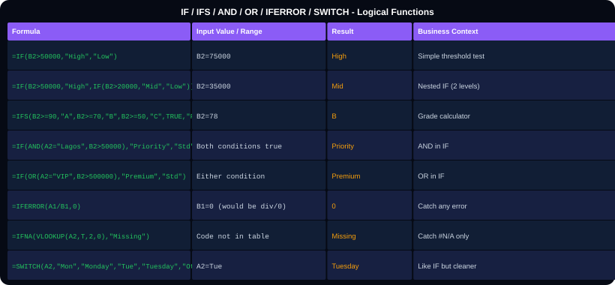
LOGICAL 01 - IF, IFS, AND, OR, NOT, IFERROR
Function
Key Explanation
=IF(cond, true_val, false_val)
Tests condition. Returns true_val if TRUE, false_val if FALSE. Both return values can be text, numbers, or other formulas.
Nested IF
=IF(A1&gt;90, "A", IF(A1&gt;70, "B", "C")). One IF inside another. Limit to 3-4 levels of nesting - use IFS for more.
=IFS(c1,v1,c2,v2,...,TRUE,vN)
Tests conditions in order. Returns value for first TRUE. Always end with TRUE as catch-all or IFS returns #N/A.
=AND(cond1, cond2, ...)
TRUE only if ALL conditions are TRUE. Use inside IF: =IF(AND(A1&gt;0, B1&lt;100), "OK", "No").
=OR(cond1, cond2, ...)
TRUE if ANY condition is TRUE. =IF(OR(A1="VIP", B1&gt;1000000), "Priority", "Standard").
=NOT(condition)
Reverses TRUE to FALSE and vice versa. =NOT(ISBLANK(A1)) = TRUE when cell has content.
=IFERROR(formula, value_if_error)
Catches ANY error (#DIV/0!, #N/A, #REF!, #VALUE!). Returns value_if_error instead. Wrap all lookups with this.
logic.xlsx
=IFNA(formula, value_if_na)
Only catches #N/A errors (not other error types). Use with VLOOKUP/XLOOKUP where #N/A means not found.
-- Real Business Examples --
=IF(C2&lt;0, "Loss", IF(C2=0, "Break Even", "Profit"))
=IFS(D2="A","Excellent",D2="B","Good",TRUE,"Review")
=IFERROR(C2/D2, 0) safe division
=IF(AND(E2&gt;50000,F2&lt;10),"Bonus","No bonus")
Notes:
Logical functions. The IFS function requires Excel 2016 or later. For compatibility with older Excel, use nested IF. The critical rule for IFS: always end with TRUE as the last condition to catch any row that does not match the earlier conditions. Without it, IFS returns #N/A when no condition matches.

Slide 11
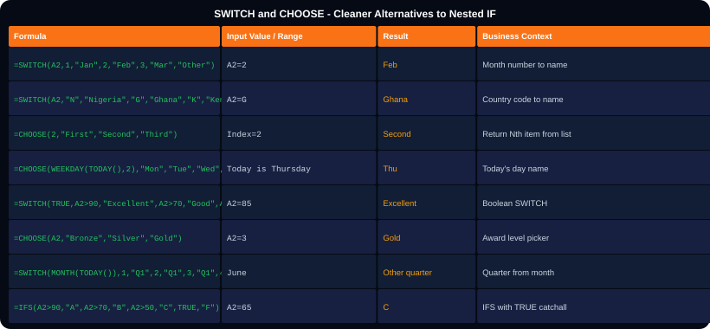
LOGICAL 02 - SWITCH and CHOOSE - Cleaner Alternatives to Nested IF
Function
Key Explanation
=SWITCH(value, v1, r1, v2, r2, ..., default)
Compares value against a list. Returns result for the first match. Optional default at the end.
=SWITCH(A1,1,"Jan",2,"Feb",3,"Mar")
Month number to name. Cleaner than nested IF for value matching.
=SWITCH(TRUE, cond1, r1, cond2, r2)
Boolean SWITCH. Set first arg to TRUE, then use conditions. Like IFS but SWITCH syntax.
=CHOOSE(index, v1, v2, v3, ...)
Returns the Nth item from a list. index=1 returns v1, index=2 returns v2, etc.
=CHOOSE(WEEKDAY(TODAY()),"Sun","Mon","Tue","Wed","Thu","Fri","Sat")
Returns today's day name. WEEKDAY returns 1=Sun in default mode.
=CHOOSE(A1,"Bronze","Silver","Gold")
If A1=1: Bronze. A1=2: Silver. A1=3: Gold. Clean award level logic.
SWITCH vs IFS
SWITCH: compares one value against many equals-checks. IFS: tests independent conditions. Use SWITCH for value matching, IFS for range comparisons.
switch.xlsx
-- SWITCH examples --
=SWITCH(A2,
"NG", "Nigeria",
"GH", "Ghana",
"KE", "Kenya",
"Unknown country")
=CHOOSE(MONTH(TODAY()),"Q1","Q1","Q1","Q2","Q2","Q2","Q3","Q3","Q3","Q4","Q4","Q4")
Notes:
SWITCH and CHOOSE. SWITCH requires Excel 2016 or later. For older Excel, use nested IF or CHOOSE. The CHOOSE with MONTH(TODAY()) trick for quarters is very elegant - it maps 12 month numbers directly to 4 quarter labels. CHOOSE with WEEKDAY is the classic way to display day names in all Excel versions.

Slide 12
🔍
CATEGORY 04
Lookup and Reference Functions
VLOOKUP, XLOOKUP, INDEX, MATCH, OFFSET, INDIRECT, CHOOSE

Slide 13
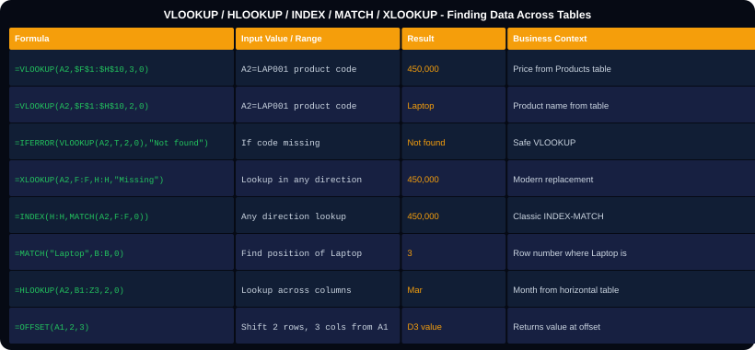
LOOKUP 01 - VLOOKUP - The Classic Lookup Function
Argument
Explanation
lookup_value
The value to search FOR. Usually a cell reference like A2. Must exist in the leftmost column of your table.
table_array
The table to search IN. Must start with the lookup column on the left. Always use $ to lock: $F$1:$H$100.
col_index_num
Which column to return. 1=first column, 2=second, 3=third. Breaks if you insert columns between.
range_lookup
ALWAYS use 0 (or FALSE) for exact match. 1 (TRUE) = approximate - only for sorted data and is dangerous.
#N/A error
Value not found in lookup column. Check spelling, trailing spaces. Wrap with IFERROR to handle gracefully.
VLOOKUP limitation 1
Lookup column MUST be the leftmost column. Cannot look left. Use INDEX-MATCH or XLOOKUP instead.
VLOOKUP limitation 2
Column number is fragile - inserts a column and your number is wrong. INDEX-MATCH or XLOOKUP reference column by name.
vlookup.xlsx
-- VLOOKUP Common Patterns --
=VLOOKUP(A2,$F$1:$H$100,3,0) basic
=IFERROR(VLOOKUP(A2,T,2,0),"") safe
=VLOOKUP(A2andB2,$F$1:$H$100,3,0) two keys
Concatenate keys to create a unique join key
=VLOOKUP(A2,INDIRECT("Sheet"andB2and"!A:C"),3,0)
VLOOKUP vs XLOOKUP
XLOOKUP has no column number. Returns the column you reference directly. Available Excel 365/2021 only.
Notes:
VLOOKUP. Despite its limitations, VLOOKUP is still the most widely used lookup function because it is available in ALL Excel versions. Key teaching moment: demonstrate the column number problem live - insert a column into the lookup table and show how VLOOKUP returns wrong data silently. This always convinces students to learn INDEX-MATCH or XLOOKUP.

Slide 14
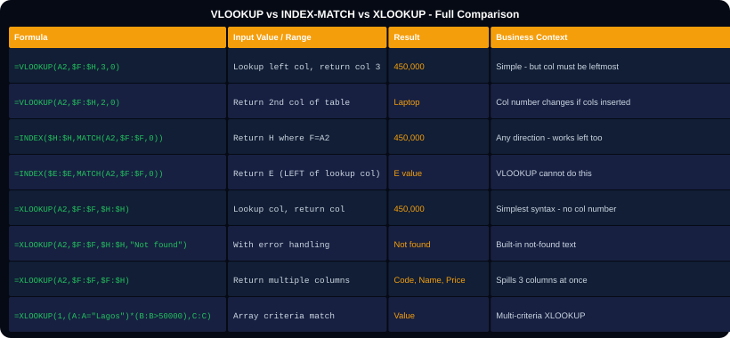
LOOKUP 02 - XLOOKUP vs INDEX-MATCH - The Modern Lookups
Technique
When and How to Use
=XLOOKUP(val, lookup_arr, return_arr)
Simplest syntax. lookup_arr is the search column. return_arr is the column to return. No column numbers.
=XLOOKUP(val, lookup, return, 'Not found')
4th argument = what to show if not found. Built-in error handling - no IFERROR needed.
=XLOOKUP(val, lookup, return, ,-1)
5th argument = match mode: 0=exact, -1=exact or smaller, 1=exact or larger, 2=wildcard.
=XLOOKUP(val, lookup, return, ,, -1)
6th argument = search mode: 1=first to last, -1=last to first (reverse). Returns last match.
=XLOOKUP(val, lookup, full_table_range)
Return MULTIPLE columns at once. XLOOKUP spills the results across columns automatically.
=INDEX(return_col, MATCH(val, lookup_col, 0))
Classic INDEX-MATCH. Works in ALL Excel versions. Can look in any direction.
MATCH(val, range, 0)
Returns the ROW NUMBER (position) where val is found in range. 0=exact. 1=ascending approx. -1=descending approx.
xlookup.xlsx
-- XLOOKUP with multiple columns --
=XLOOKUP(A2,Products[Code],Products[A:C])
Returns code, name AND price in one formula
-- INDEX-MATCH with MAX --
=INDEX(A:A, MATCH(MAX(B:B), B:B, 0))
Name of the highest-value transaction
=INDEX(arr, MATCH(MAX(B:B), B:B, 0))
Find the name/value associated with the maximum - impossible with VLOOKUP alone.
Notes:
XLOOKUP and INDEX-MATCH. XLOOKUP is available Excel 365 and Excel 2021 only. For maximum compatibility (shared with Excel 2016/2019 users), use INDEX-MATCH. The INDEX-MATCH combination with MAX is one of the most powerful patterns: find the category/name/region that has the highest/lowest value - something that requires a very complex workaround in VLOOKUP.

Slide 15
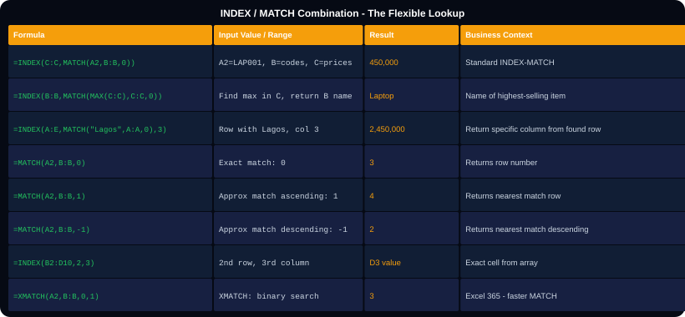
LOOKUP 03 - INDEX and MATCH - Deep Dive
Function
Explanation
=MATCH(val, range, 0)
Finds WHERE a value is in a range. Returns position number. 0=exact. Use as row number input for INDEX.
=INDEX(array, row, col)
Returns the value AT a specific position. INDEX(A:C, 3, 2) = value in row 3, column 2 of columns A to C.
Why combine them?
MATCH gives you the position. INDEX uses the position to return a value. Together: find and return any data in any direction.
=INDEX(B:B, MATCH(A2,C:C,0))
Return from B where C matches A2. Looking LEFT (B is left of C). VLOOKUP cannot do this.
Two-way lookup
=INDEX(B2:E10, MATCH(G1,A2:A10,0), MATCH(H1,B1:E1,0)). Find intersection of row and column headers.
=XMATCH(val, range)
Excel 365: cleaner MATCH. Returns position. Has wildcard and binary search modes built in.
Array MATCH
=MATCH(1, (A:A="Lagos")*(B:B="Laptop"), 0). Multiply two conditions to find multi-criteria position.
indexmatch.xlsx
-- Two-way lookup --
=INDEX(B2:E10,
MATCH(H1, A2:A10, 0),
MATCH(H2, B1:E1, 0))
Find value at intersection of Row and Column
-- Multi-criteria INDEX-MATCH --
=INDEX(C:C, MATCH(1, (A:A="Lagos")*(B:B="Laptop"), 0))
Notes:
INDEX-MATCH deep dive. The two-way lookup is the most powerful application: look up a value at the intersection of a row label and a column label. This creates a dynamic cross-reference table. The multi-criteria MATCH uses array logic: multiplying two TRUE/FALSE arrays gives 1 only where BOTH conditions are true, then MATCH finds the first 1.

Slide 16
LOOKUP 04 - OFFSET, INDIRECT, ADDRESS, HYPERLINK
lookup4.xlsx
Function
When to Use It
-- OFFSET --
=OFFSET(reference, rows, cols, height, width)
=OFFSET(A1, 2, 3) -&gt; value in D3
Start at A1, move 2 rows down, 3 cols right
=OFFSET(A1, 0, 0, COUNTA(A:A), 1)
Dynamic range that expands with data
-- INDIRECT --
=INDIRECT("A1") -&gt; value of A1
=INDIRECT("Sheet2!B3") -&gt; B3 on Sheet2
=INDIRECT(A1) -&gt; value of cell in A1's text
If A1 = "B5", returns value in B5
=SUMIF(INDIRECT(A1and"!B:B"),"X",INDIRECT(A1and"!C:C"))
Dynamic sheet reference for multi-sheet SUMIF
-- ADDRESS --
=ADDRESS(3, 2) -&gt; "$B$3"
=ADDRESS(3, 2, 4) -&gt; "B3" (relative)
=INDIRECT(ADDRESS(MATCH(MAX(B:B),B:B,0), 1))
Cell address of the maximum value
-- ROW and COLUMN --
=ROW() Row number of current cell
=ROW(A5) -&gt; 5 (row number of A5)
=COLUMN(D1) -&gt; 4 (D is 4th column)
=ROWS(A1:A100) -&gt; 100 (count of rows)
=COLUMNS(A1:Z1) -&gt; 26 (count of columns)
=OFFSET(ref, rows, cols)
Navigate relative to a starting cell. Used in dynamic named ranges. Volatile - recalculates every time.
=INDIRECT(text)
Converts text to a cell reference. Use to build dynamic sheet references: =INDIRECT(A1and"!B:B") where A1 contains a sheet name.
INDIRECT for dependent dropdowns
Name ranges by country. =INDIRECT(A2) in Data Validation reads A2's value as a range name, enabling country-city dependent dropdowns.
=ADDRESS(row, col)
Returns a cell address as text. ADDRESS(3,2) = "$B$3". Combine with INDIRECT: =INDIRECT(ADDRESS(r,c)) to navigate dynamically.
=ROW() and COLUMN()
ROW() returns current row number. ROW(A5) returns 5. Use =ROW()-1 to create sequential numbers that renumber when rows deleted.
=ROWS(array) and COLUMNS(array)
Count rows or columns in a range. ROWS(A1:A100)=100. Use in dynamic formulas: =SUM(OFFSET(A1,0,0,ROWS(B:B),1)).
=CHOOSE with OFFSET
=CHOOSE(A1, OFFSET(data,0,0), OFFSET(data,0,1)) selects different column ranges based on a dropdown value.
Notes:
OFFSET and INDIRECT are advanced functions. INDIRECT is particularly useful for building multi-sheet reports where the sheet name changes based on a dropdown selection. OFFSET is used in legacy dynamic named ranges (before Excel Tables became standard). Both are volatile functions - they recalculate on every sheet change which can slow down large workbooks.

Slide 17
Aa
CATEGORY 05
Text Functions
TRIM, LEFT, RIGHT, MID, LEN, FIND, SUBSTITUTE, TEXTJOIN, TEXT

Slide 18
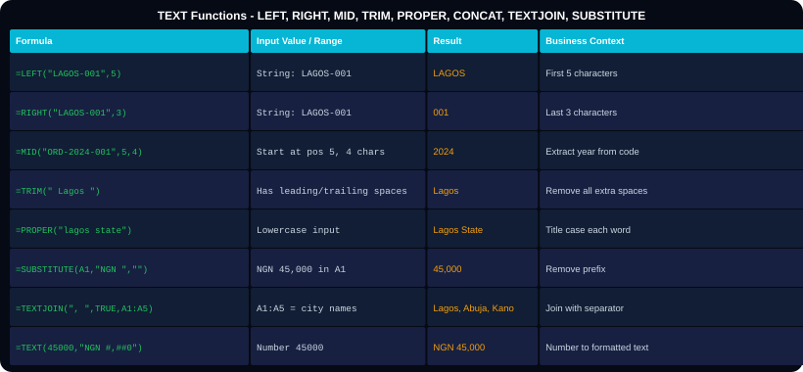
TEXT 01 - Extract, Clean, Join, and Format Text
Function
What It Does
=LEFT(text, n)
Returns first n characters. =LEFT("LAGOS-001",5) = 'LAGOS'. Use to extract prefixes.
=RIGHT(text, n)
Returns last n characters. =RIGHT("ORD-001",3) = '001'. Use to extract suffixes.
=MID(text, start, n)
Returns n chars starting at position start. =MID("ORD-2024-001",5,4) = '2024'.
=LEN(text)
Returns number of characters. =LEN("Lagos") = 5. Use to validate field lengths.
=TRIM(text)
Removes ALL leading, trailing, and EXTRA interior spaces. ' Lagos ' becomes 'Lagos'.
=CLEAN(text)
Removes non-printable characters. Use on data copied from web pages or PDFs.
=FIND(find, within, start)
Position of text - CASE SENSITIVE. =FIND("a","Lagos") = 2.
text.xlsx
-- Extract between delimiters --
A1 = "ORD-2024-00145"
Year = =MID(A1,5,4) -&gt; 2024
Num = =RIGHT(A1,5) -&gt; 00145
Prefix=LEFT(A1,FIND("-",A1)-1) -&gt; ORD
=SEARCH(find, within)
Position of text - NOT case sensitive. =SEARCH("lagos","A Lagos B") = 3.
=SUBSTITUTE(text,old,new,n)
Replaces text. 4th argument n: which occurrence (optional). =SUBSTITUTE(A1,"-","/") replaces all hyphens.
Notes:
Text functions. The FIND-based extraction is the most important advanced text technique. =LEFT(A1,FIND("-",A1)-1) extracts everything before the first hyphen. This adapts to different lengths, unlike =LEFT(A1,3) which would only work for fixed-length prefixes. SUBSTITUTE is faster than Find & Replace for automated workflows.

Slide 19
TEXT 02 - CONCAT, TEXTJOIN, TEXT, VALUE, REPT, UPPER, LOWER
text2.xlsx
Function
Explanation
-- Joining Text --
=A1and" "andB1 Ampersand join
=CONCAT(A1," ",B1) Excel 2016+ concat
=CONCATENATE(A1," ",B1) Old version
=TEXTJOIN(", ",TRUE,A1:A5) Join with separator, skip blanks
=TEXTJOIN(" | ",FALSE,A1:A5) Include blanks
-- Number/Date Formatting --
=TEXT(45000,"NGN #,##0") -&gt; NGN 45,000
=TEXT(0.245,"0.0%") -&gt; 24.5%
=TEXT(TODAY(),"DD MMM YYYY") -&gt; 25 Jun 2026
=TEXT(TODAY(),"DDDD") -&gt; Thursday
=TEXT(A1,"000000") -&gt; 000045 (pad)
-- Convert Types --
=VALUE("45000") -&gt; 45000 (text to number)
=VALUE("24.5%") -&gt; 0.245 (percent to decimal)
=N(TRUE) -&gt; 1 (logical to number)
=T(45000) -&gt; "" (number to text: empty if number)
-- Case Conversion --
=UPPER("lagos") -&gt; LAGOS
=LOWER("LAGOS") -&gt; lagos
=PROPER("lagos state")-&gt; Lagos State
-- Repeat and Pad --
=REPT("*",5) -&gt; *****
=REPT("*",ROUND(A1/10000,0)) Star rating bar in cell
=TEXT(A1,"@"andREPT(" ",10-LEN(A1))) Pad to 10 chars
=TEXTJOIN(",", TRUE, A1:A5)
Joins all values with a comma separator. TRUE skips blank cells. Available Excel 2016+. Best for creating comma-separated lists.
=TEXT(number, format)
Converts a number to a formatted text string. Format codes same as custom number formats. Unlike cell formatting, this creates TEXT that can be concatenated.
=VALUE(text)
Converts text that looks like a number to an actual number. Fixes numbers stored as text (left-aligned numbers). =VALUE(TRIM(A1)) handles spaces too.
=REPT(text, n)
Repeats text n times. =REPT("*", ROUND(A1/10000,0)) creates a visual star bar based on a value - a sparkline within text.
=PROPER(text)
Capitalises first letter of each word. =PROPER(TRIM(A1)) is the standard data cleaning combination for name columns.
=SUBSTITUTE(A1,CHAR(10),", ")
CHAR(10) is the newline character (Alt+Enter). Replace line breaks with comma-space to join multi-line cell content.
Notes:
Text functions part 2. The REPT star rating is a fun and useful trick for dashboards. =REPT(CHAR(9733),ROUND(A1,0)) creates star characters. TEXT() format codes are the same as custom number formats in Format Cells. The combination TEXT(value, format)&" "&other_text is used constantly in report headings and dashboard labels.

Slide 20
📅
CATEGORY 06
Date and Time Functions
TODAY, DATE, DATEDIF, EDATE, EOMONTH, WORKDAY, NETWORKDAYS

Slide 21
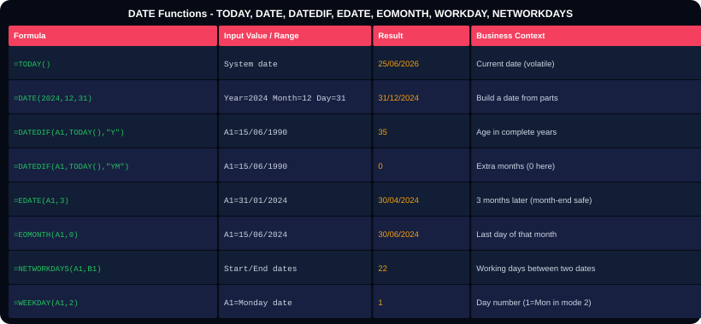
DATE 01 - Date Creation, Extraction, and Arithmetic
Function
Explanation
=TODAY()
Returns today's date. Volatile - updates every time worksheet recalculates. Format: 25/06/2026.
=NOW()
Returns current date AND time. Also volatile. Use =INT(NOW()) to get today's date without time.
=DATE(year, month, day)
Constructs a date from three numbers. =DATE(2024,12,31) = 31 December 2024. Handles roll-over: DATE(2024,13,1) = 01 Jan 2025.
=DATEDIF(start, end, unit)
Calculates date differences. Units: D=days, M=months, Y=years, YM=months excluding years, YD=days excluding years.
=EDATE(start_date, months)
Adds/subtracts months from a date. Handles month-end correctly: EDATE(31/01/2024,1) = 29/02/2024 (not 31st Feb).
=EOMONTH(start_date, months)
Returns last day of a month. EOMONTH(A1,0) = last day of A1's month. EOMONTH(A1,-1)+1 = first day of A1's month.
=NETWORKDAYS(start,end,holidays)
Business days between two dates, excluding weekends. Add optional holidays range: a list of public holiday dates.
dates.xlsx
-- Age and Tenure Calculator --
Years = =DATEDIF(B2,TODAY(),"Y")
Months= =DATEDIF(B2,TODAY(),"YM")
Full = =DATEDIF(B2,TODAY(),"Y")and" yrs "and
DATEDIF(B2,TODAY(),"YM")and" mths"
Invoice Overdue: =TODAY()-A2 &gt; 30
=WORKDAY(start_date, days)
Returns a date N working days after start. WORKDAY(TODAY(),30) = date 30 working days from now.
Notes:
Date functions. DATEDIF is a hidden function - it does not appear in autocomplete but works in all Excel versions. The YM unit gives months excluding complete years, and YD gives days excluding complete years. These are used for 'Age: 35 years, 8 months' type displays. EOMONTH is essential for financial month-end calculations.

Slide 22
DATE 02 - Date Parts, Week Numbers, and Time Functions
date2.xlsx
Scenario
Formula Solution
-- Extract Date Parts --
=YEAR(A1) Extract year: 2024
=MONTH(A1) Extract month: 6
=DAY(A1) Extract day: 25
=WEEKDAY(A1) Day of week: 1=Sun default
=WEEKDAY(A1,2) Day of week: 1=Mon
=WEEKNUM(A1) Week number of year: 26
=ISOWEEKNUM(A1) ISO week number
=TEXT(A1,"MMMM") Month name: June
=TEXT(A1,"MMM") Short: Jun
=TEXT(A1,"DDDD") Day name: Thursday
=TEXT(A1,"DDD") Short: Thu
-- Quarter Calculation --
=CHOOSE(MONTH(A1),"Q1","Q1","Q1","Q2","Q2","Q2","Q3","Q3","Q3","Q4","Q4","Q4")
=INT((MONTH(A1)-1)/3)+1 Quarter number 1-4
-- Time Functions --
=HOUR(A1) Extract hour (0-23)
=MINUTE(A1) Extract minutes (0-59)
=SECOND(A1) Extract seconds (0-59)
=TIME(9, 30, 0) Build time: 9:30 AM
=NOW()-INT(NOW()) Current time only
=A2-A1 Time elapsed (format as [h]:mm)
=MOD(A1,1) Extract time from datetime
Age display: 35 years, 8 months
=DATEDIF(DOB,TODAY(),"Y")and" years, "andDATEDIF(DOB,TODAY(),"YM")and" months"
First day of a month
=EOMONTH(A1,-1)+1 or =DATE(YEAR(A1),MONTH(A1),1)
Last day of a month
=EOMONTH(A1,0)
Same date next year
=DATE(YEAR(A1)+1,MONTH(A1),DAY(A1))
Days remaining until deadline
=DEADLINE-TODAY(). Format as Number, not Date.
Is weekend? (TRUE/FALSE)
=OR(WEEKDAY(A1,2)=6, WEEKDAY(A1,2)=7)
Quarter label Q1/Q2/Q3/Q4
=CHOOSE(MONTH(A1),"Q1","Q1","Q1","Q2","Q2","Q2","Q3","Q3","Q3","Q4","Q4","Q4")
Time between two times as hours
=(B1-A1)*24. Multiply by 24 converts Excel time fraction to hours.
Notes:
Date part 2. The quarter formula using CHOOSE is the cleanest approach. The INT((MONTH-1)/3)+1 formula is a mathematical alternative. For time elapsed, remember that Excel stores time as a fraction of a day (0.5 = noon). To convert time difference to hours, multiply by 24. Format duration with [h]:mm format to show hours greater than 24.

Slide 23
ℹ
CATEGORY 07
Information Functions
ISBLANK, ISNUMBER, ISTEXT, ISERROR, ISNA, TYPE, CELL, N

Slide 24
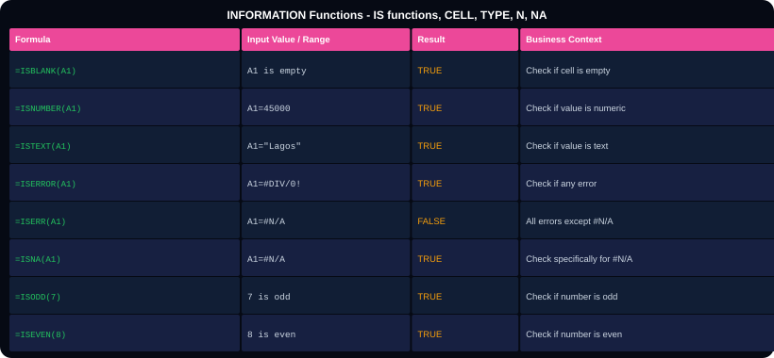
INFORMATION - IS Functions, CELL, TYPE
Function
Returns and When to Use
=ISBLANK(A1)
TRUE if cell is completely empty. FALSE if has any value including spaces. Pair with IF: =IF(ISBLANK(A1),"Empty",A1).
=ISNUMBER(A1)
TRUE if cell contains a numeric value. Use to validate inputs or debug why SUM is not working (text numbers).
=ISTEXT(A1)
TRUE if cell contains text. Numbers left-aligned are often text - ISTEXT(A1) reveals this.
=ISERROR(A1)
TRUE for ANY error: #DIV/0!, #N/A, #REF!, #VALUE!, #NAME!, #NUM!. Use in conditional formatting to highlight error cells.
=ISERR(A1)
TRUE for all errors EXCEPT #N/A. Use when you want #N/A to pass through (e.g. during a deliberate not-found).
=ISNA(A1)
TRUE specifically for #N/A errors. Use to detect when a lookup did not find a match.
=ISODD(number)
TRUE if number is odd. =ISODD(ROW()) inside conditional formatting creates alternating row colours.
info.xlsx
-- Practical IS function patterns --
Validate input: =IF(ISBLANK(B2),"Required","OK")
Fix text numbers: =IF(ISNUMBER(A1),A1,VALUE(A1))
Alternating rows in CF: =ISODD(ROW())
Error check: =IF(ISERROR(formula),"",formula)
NA check: =IF(ISNA(VLOOKUP(...)),"Missing","OK")
=TYPE(A1)
Returns: 1=number, 2=text, 4=logical, 16=error, 64=array. More detailed than IS functions.
Notes:
Information functions. ISBLANK is critical for data validation and avoiding blank-cell errors. Note: ISBLANK returns FALSE for cells that contain a space (' ') - the cell looks empty but is not. Always use TRIM first: =ISBLANK(TRIM(A1)) is unreliable because TRIM returns a text result. Better: =LEN(TRIM(A1))=0 to test for truly blank or space-only cells.

Slide 25
💰
CATEGORY 08
Financial Functions
PMT, PV, FV, RATE, NPER, NPV, IRR, XIRR, XNPV

Slide 26
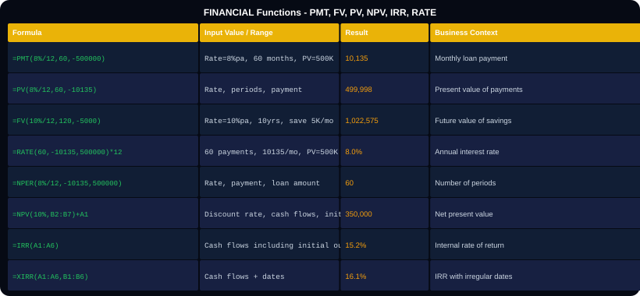
FINANCIAL - Loan, Investment, and Valuation Functions
Function
What It Calculates
=PMT(rate, nper, pv)
Monthly loan payment. rate=monthly rate (annual%/12). nper=total payments. pv=loan amount (negative PV convention).
=PV(rate, nper, pmt)
Present value of a series of payments. How much is a stream of future payments worth today?
=FV(rate, nper, pmt)
Future value of regular savings. How much will NGN 5,000/month grow to in 10 years at 10%?
=RATE(nper, pmt, pv)*12
Annual interest rate given loan details. Multiply monthly result by 12 for annual rate.
=NPER(rate, pmt, pv)
Number of payment periods needed. How many months to pay off a loan?
=NPV(discount_rate, cashflows)
Net present value of future cash flows. Add initial investment separately: =NPV(10%,B2:B7)+A1.
=IRR(cashflows)
Internal rate of return. First value should be negative (initial outlay). Returns period rate.
financial.xlsx
-- Loan Calculator Example --
Loan amount: NGN 5,000,000
Annual rate: 18% (bank rate Nigeria)
Term: 36 months
=PMT(18%/12, 36, -5000000) -&gt; NGN 180,734/mo
=PMT(18%/12, 36, -5000000)*36 -&gt; Total paid
Total interest = Total paid - 5,000,000
=XIRR(cashflows, dates)
IRR when cash flows happen at irregular intervals. More accurate than IRR for real investments.
Notes:
Financial functions. The sign convention trips up beginners. In PMT, PV, and FV: money you RECEIVE is positive, money you PAY OUT is negative. So a loan amount you RECEIVE is positive PV, but you enter it as negative in PMT (because you are committing to pay). Or use negative PV: PMT(rate,nper,-5000000) to get a positive monthly payment result.

Slide 27
{}
CATEGORY 09
Dynamic Array Functions (Excel 365)
FILTER, SORT, UNIQUE, SEQUENCE, TEXTSPLIT, TOCOL, TOROW

Slide 28
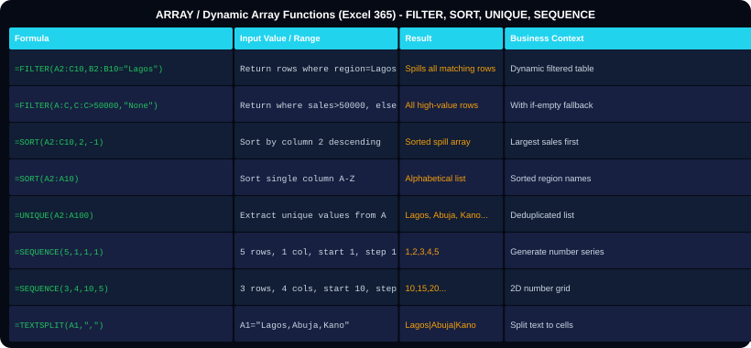
ARRAY 01 - FILTER, SORT, UNIQUE, SEQUENCE - Dynamic Results
Function
What It Does - Excel 365/2021 Only
=FILTER(array, include)
Returns only the rows where include is TRUE. Spills results downward. =FILTER(A:C, B:B="Lagos") returns all Lagos rows.
=FILTER(arr, include, empty_msg)
Third argument: what to show if no rows match. =FILTER(A:C, B:B="Abuja", "No Abuja data").
=SORT(array, sort_index, order)
Sorts an array. sort_index=column to sort by. order: 1=ascending, -1=descending. Spills sorted result.
=SORT(A2:C100, 3, -1)
Sorts A2:C100 by column 3, descending. Highest values first.
=UNIQUE(array)
Returns unique values from an array. Removes duplicates automatically. Spills downward.
=UNIQUE(A2:A100, FALSE, TRUE)
3rd argument TRUE: return values that appear EXACTLY ONCE (not just unique list).
=SEQUENCE(rows, cols, start, step)
Generates a number sequence. SEQUENCE(5,1,1,1) = 1,2,3,4,5. SEQUENCE(1,12,1,1) = 1 through 12 across.
array.xlsx
-- Combining Array Functions --
=SORT(FILTER(A:C,B:B="Lagos"),3,-1)
Filter to Lagos, then sort by col 3 desc
=UNIQUE(FILTER(A:A,B:B&gt;50000))
Unique regions where sales &gt; 50,000
=SEQUENCE(12,1,DATE(2024,1,1),30)
=TEXTSPLIT(text, col_delim)
Splits text into cells. =TEXTSPLIT("Lagos,Abuja,Kano",",") = three cells across.
Notes:
Dynamic array functions. These require Excel 365 or Excel 2021. In Excel 2019 and earlier, FILTER, SORT, and UNIQUE do not exist. The key concept: these functions SPILL their results into multiple cells automatically. You enter the formula in ONE cell and results fill neighbouring cells. If another value is in those cells, you get a #SPILL! error - clear the cells first.

Slide 29
ARRAY 02 - TOCOL, TOROW, VSTACK, HSTACK, BYROW, BYCOL
array2.xlsx
Function
What It Does
-- Stack Arrays --
=VSTACK(A1:C5, A1:C5) Stack vertically
Appends second array below first
=HSTACK(A1:C5, E1:G5) Stack horizontally
Appends second array to right of first
-- Reshape Arrays --
=TOCOL(A1:C5) Make one tall column
Reads A1:C5 left-to-right, top-to-bottom
=TOROW(A1:A10) Make one wide row
=WRAPROWS(A1:A24,4) Wrap into 4-col array
=WRAPCOLS(A1:A24,4) Wrap into 4-row array
-- Apply Functions to Each Row/Col --
=BYROW(A2:C10, LAMBDA(r, SUM(r)))
Sum each row across columns A-C
=BYCOL(A2:C10, LAMBDA(c, MAX(c)))
Max of each column
-- LAMBDA - Custom Functions --
Name Manager -&gt; New -&gt; Name: CircleArea
Refers to: =LAMBDA(r, PI()*r^2)
Use: =CircleArea(5) -&gt; 78.54
-- LET - Named Variables in Formula --
=LET(tax_rate, 0.075,
amount, B2,
amount + amount * tax_rate)
LET stores intermediate results for readability
=VSTACK(arr1, arr2)
Stacks arrays vertically. Use to combine Jan, Feb, Mar tables: =VSTACK(Jan,Feb,Mar). Excel 365 only.
=HSTACK(arr1, arr2)
Stacks arrays horizontally (side by side). Adds columns. Excel 365 only.
=TOCOL(array)
Flattens a 2D array into a single column. Used with UNIQUE to get all unique values across multiple columns.
=BYROW(arr, LAMBDA(r,fn))
Applies a function to each ROW. The LAMBDA defines what to do with each row r.
=BYCOL(arr, LAMBDA(c,fn))
Applies a function to each COLUMN. The LAMBDA defines what to do with each column c.
LAMBDA function
Creates a reusable custom function within Excel (no VBA). Define in Name Manager, use like any built-in function.
LET function
Names intermediate calculations within a formula. Avoids repeating the same complex sub-formula multiple times.
Notes:
Advanced array functions. LAMBDA and LET are game-changers for complex formulas. LET is particularly useful when you have a formula that computes the same intermediate value multiple times. Instead of =IF(SUMIF(...)>1000,SUMIF(...)*0.9,SUMIF(...)), use LET to compute SUMIF once, store it, then use the name twice.

Slide 30
📈
CATEGORY 10
Advanced Statistical Functions
STDEV, VAR, CORREL, FORECAST, LINEST, NORM.DIST, PERCENTILE

Slide 31
ADVANCED STATISTICAL - Forecasting, Distribution, Regression
adv_stats.xlsx
Function
Business Application
-- Variability --
=STDEV(B2:B100) Sample std deviation
=STDEVP(B2:B100) Population std deviation
=VAR(B2:B100) Sample variance
=VARP(B2:B100) Population variance
=KURT(B2:B100) Kurtosis (peak vs normal)
=SKEW(B2:B100) Skewness (distribution tail)
-- Correlation and Regression --
=CORREL(B2:B100, C2:C100) Pearson correlation
=PEARSON(B2:B100, C2:C100) Same as CORREL
=COVARIANCE.S(B:B, C:C) Sample covariance
=RSQ(B2:B100, C2:C100) R-squared
=SLOPE(y_values, x_values) Regression slope
=INTERCEPT(y_vals,x_vals) Y-intercept
-- Forecasting --
=FORECAST.LINEAR(x, y_range, x_range)
Predict y-value for given x using linear
=FORECAST.ETS(target_date, values, timeline)
Exponential smoothing forecast with seasonality
=TREND(known_y, known_x, new_x)
Returns array of trend values (Ctrl+Shift+Enter)
=GROWTH(known_y, known_x, new_x)
Exponential growth trend
-- Distribution Functions --
=NORM.DIST(x,mean,stdev,TRUE) Cumulative prob
=NORM.INV(0.95,mean,stdev) 95th pct value
=T.DIST(t_stat,df,TRUE) t-distribution
=CONFIDENCE.T(0.05,stdev,n) Confidence interval
=STDEV(range)
Measures spread. Low STDEV = consistent quality. High STDEV = variable performance. Use in quality control.
=CORREL(x_range, y_range)
Measures how strongly two variables move together. CORREL(advertising,sales) shows if spending drives revenue.
=FORECAST.LINEAR(x,y,x_data)
Predicts a value based on historical trend. Forecast next month's sales given historical data.
=FORECAST.ETS(date,values,timeline)
More advanced forecast that detects seasonal patterns. Better for data with regular seasonal cycles.
=PERCENTILE(range, k)
Returns value at kth percentile. PERCENTILE(salaries, 0.75) = 75th percentile salary for benchmarking.
=CONFIDENCE.T(alpha, stdev, n)
Returns margin of error for a confidence interval. alpha=0.05 for 95% confidence. Add/subtract from mean.
=LINEST(y_vals, x_vals, TRUE, TRUE)
Returns regression statistics as array. Enter with Ctrl+Shift+Enter for full output including R^2 and F statistic.
Notes:
Advanced statistics. FORECAST.ETS (Excel 2016+) is powerful for business forecasting because it handles seasonality automatically. It detects whether your data has monthly, quarterly, or annual patterns and incorporates them. CORREL is the most practical - used to justify (or disprove) assumptions about cause-and-effect relationships in data.

Slide 32
🗄
CATEGORY 11
Database Functions
DSUM, DCOUNT, DAVERAGE, DMAX, DMIN, DGET

Slide 33
DATABASE FUNCTIONS - Criteria-Based Calculations with Headers
database.xlsx
Function vs SUMIFS
Database functions use a separate criteria RANGE on the worksheet, making them easy to see and change. SUMIFS embeds criteria in the formula. Both are valid - use whichever is clearer.
-- Database Functions Structure --
=DSUM(database, field, criteria)
=DCOUNT(database, field, criteria)
=DAVERAGE(database, field, criteria)
=DMAX(database, field, criteria)
=DMIN(database, field, criteria)
=DGET(database, field, criteria)
-- Arguments --
database: full table including headers A1:E100
field: column name in quotes "Sales"
or column number 3
criteria: a separate range with headers
and criteria values below
-- Criteria Range Setup --
H1: Region I1: Sales
H2: Lagos I2: &gt;50000
=DSUM(A1:E100, "Sales", H1:I2)
Sum Sales where Region=Lagos AND Sales&gt;50000
-- OR Criteria (multiple rows) --
H1: Region
H2: Lagos &lt;- OR condition 1
H3: Abuja &lt;- OR condition 2
=DSUM(A1:E100, "Sales", H1:H3)
Sum where Region=Lagos OR Region=Abuja
=DSUM advantage
Complex OR conditions are cleaner with DSUM - just add more rows to the criteria range. SUMIFS requires separate SUMIFS formulas added together.
=DGET
Returns a SINGLE matching value (like VLOOKUP but with criteria range). Returns #VALUE! if multiple rows match. Returns #VALUE! if no match.
Criteria range rules
Must have the same column headers as the database. Criteria in the same row = AND. Criteria in different rows = OR.
Wildcard in criteria
Put wildcards in the criteria range: *Lagos* matches any cell containing Lagos. Works in all D-functions.
When to use
Use Database functions when you have complex criteria that users need to see and change easily, or when you need OR conditions across the same field.
Notes:
Database functions. These are often overlooked but powerful. The criteria range approach makes them highly user-friendly in dashboard contexts - users can type criteria into visible cells without modifying formulas. DSUM with an OR criteria range (multiple rows for the same field) is cleaner than summing multiple SUMIFS.

Slide 34
FORMULA ERRORS - Understanding and Fixing Every Error Type
#DIV/0!
Cause: Dividing by zero or empty cell
#N/A
Cause: Lookup value not found in table
Fix: =IFERROR(A1/B1,0) or =IF(B1=0,0,A1/B1)
Fix: =IFERROR(VLOOKUP(...),"Not found") or use XLOOKUP's 4th arg
#REF!
Cause: Referenced cells were deleted
#VALUE!
Cause: Wrong data type in formula
Fix: Check formula. The range being referenced was removed. Update formula to valid range.
Fix: Text where number expected. =VALUE(A1) to convert. Check for spaces in numeric cells.
#NAME?
Cause: Function name is misspelled
#NUM!
Cause: Invalid numeric value
Fix: Check spelling. Type =SU and press Tab to autocomplete. Missing quotes around text criteria.
Fix: =SQRT(-1) returns #NUM! Square root of negative. Or result is too large/small for Excel.
#NULL!
Cause: Invalid range operator
####
Cause: Column too narrow to display
Fix: =SUM(A1 B1) - space between ranges means intersection. Should be =SUM(A1,B1) with comma.
Fix: Not an error. Double-click column border to auto-fit. Or value is a negative date.
Notes:
Formula errors. The golden rule: wrap EVERY lookup function with IFERROR as a habit. #DIV/0! and #N/A are the most common. A simple habit: after writing a VLOOKUP, immediately wrap it: =IFERROR(VLOOKUP(...),'Not found'). The #### 'error' is not a real error - it just means the column is too narrow to display the value.

Slide 35
EXCEL FUNCTIONS - THE ULTIMATE QUICK REFERENCE
=SUM(range)
=COUNTIF(r,crit)
=SWITCH(val,v1,r1,...,def)
=TEXTJOIN(delim,skip,range)
=SUMIF(range,criteria,sum_r)
=COUNTIFS(r1,c1,r2,c2)
=CHOOSE(idx,v1,v2,v3)
=FIND(find,within)
=SUMIFS(sum_r,r1,c1,r2,c2)
=MAX(r) =MIN(r)
=VLOOKUP(v,tbl,col,0)
=VALUE(text)
=ROUND(num,digits)
=LARGE(r,k) =SMALL(r,k)
=XLOOKUP(v,lkp,ret,"NF")
=TODAY() =NOW()
=ROUNDUP/DOWN(num,d)
=MEDIAN(r) =MODE(r)
=INDEX(arr,row,col)
=DATE(y,m,d)
=INT(num)
=STDEV(r) =VAR(r)
=MATCH(v,range,0)
=YEAR(d) =MONTH(d) =DAY(d)
=MOD(num,divisor)
=RANK(v,r,0)
=OFFSET(ref,rows,cols)
=DATEDIF(s,e,unit)
=ABS(num)
=PERCENTILE(r,k)
=INDIRECT(text_ref)
=EDATE(d,months)
=POWER(num,power)
=CORREL(r1,r2)
=LEFT(t,n) =RIGHT(t,n)
=EOMONTH(d,months)
=SQRT(num)
=IF(cond,true,false)
=MID(t,start,n)
=NETWORKDAYS(s,e)
=RAND() =RANDBETWEEN(l,h)
=IFS(c1,v1,c2,v2,TRUE,v)
=LEN(text)
=WEEKDAY(d,2)
=SUBTOTAL(9,range)
=AND(c1,c2) =OR(c1,c2)
=TRIM(t) =CLEAN(t)
=ISBLANK(A1) =ISNUMBER(A1)
=AVERAGE(range)
=NOT(condition)
=UPPER(t) =LOWER(t) =PROPER(t)
=ISTEXT(A1) =ISERROR(A1)
=AVERAGEIF(r,crit,avg_r)
=IFERROR(formula,val)
=SUBSTITUTE(t,old,new)
=ISNA(A1) =ISODD(n)
=COUNT(r) =COUNTA(r)
=IFNA(formula,val)
=TEXT(num,format)
Math
Stats
Logic
Lookup
Text
Date
Info
Notes:
Quick reference cheat sheet. Print this slide and give to every student. Color-coded by category. All 70+ most-used functions on one page.

Slide 36
fx
Excel Functions
Complete Reference
11 Categories covered:
Math and Trig
Statistical
Logical
Lookup and Ref
Text Functions
Date and Time
Information
Financial
Array (365)
Adv Statistical
Database
Master 10 functions and you can solve 80% of Excel problems.
The 10 Functions That Solve 80% of Problems:
=SUM
=SUMIFS
=IF
=IFERROR
=VLOOKUP / XLOOKUP
Kajola Gbenga Adewale
=INDEX + MATCH
=COUNTIF
=TRIM + PROPER
=TEXT
=TODAY + DATEDIF
Data Analytics Expert
Notes:
Closing. The 80/20 rule of Excel functions: SUM, SUMIFS, IF, IFERROR, VLOOKUP/XLOOKUP, INDEX+MATCH, COUNTIF, TRIM+PROPER, TEXT, TODAY+DATEDIF. Mastering these 10 will handle the vast majority of real-world Excel tasks. Everything else builds on top of these fundamentals.

